Slide 2
Genetic diversity of ASFV Survivor pigs in Uganda
Peter Ogweng
Uganda, Makerere University

Slide 3
Presentation outline
Introduction
ASFV resistance heritability
Brief discussion and conclusion

Slide 4
Introduction
Wild pigs and soft ticks are resistant to ASFV.
Some domestic pig breeds seem to survive ASF outbreaks.
Innate immunity is likely in endemic areas like Uganda.
It is not well understood whether there is a genetic basis for this phenomenon

Slide 5
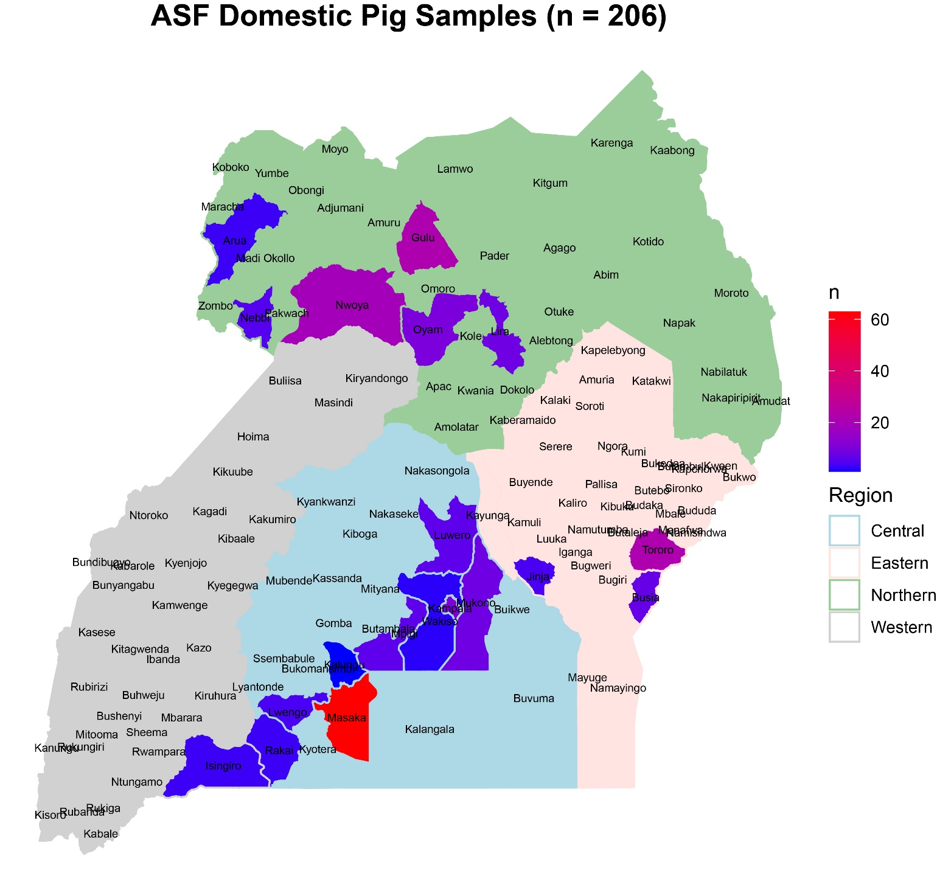
Materials and methods
Figure 1: A map of Uganda showing the number of samples by district.

Slide 6
ASFV RESISTANCE HERITABILITY
Genomic DNA extraction: 100µl of whole blood/ 10 mg of tissue (QIAGEN/DNeasy kit)
206 domestic swine were genotyped for 658,692 SNP ( Affymetrix Axiom Porcine Genotyping Array).
Full study population
206 domestic swine sampled, 63 operations (19 districts; 2010 to 2021).
119 ASFV positive (cases) and 87 ASFV negative (controls), 466,268 SNP
Sub-set study population
129 domestic swine, 33 operations (15 districts; 2010 t0 2019).
Cases (n = 65), and controls (n = 64), 466,254 SNP

Slide 7
RESULTS
Full Study population
1 A: Genome-wide Association Study -Single Locus Mixed Model (EMMAX)
Table 2: Summary of genome-wide association studies
Mode of Inheritance | Covariate(s) | Pseudo-heritability | Std Error of heritability | Pseudo Lambda | Significant SNP
Additive (GRM) | NA | 0.63 | 0.19 | 1.00 | 34
Additive (IBS) | NA | 0.71 | 0.22 | 1.02 | 35
Dominant | NA | 0.71 | 0.22 | 1.00 | 38
Recessive | NA | 0.71 | 0.22 | 1.00 | 3
110 Significant SNPs
Note: Highly heritable (>0.40), Moderately heritable (>0.30) and Lowly heritable (<0.20)

Slide 8
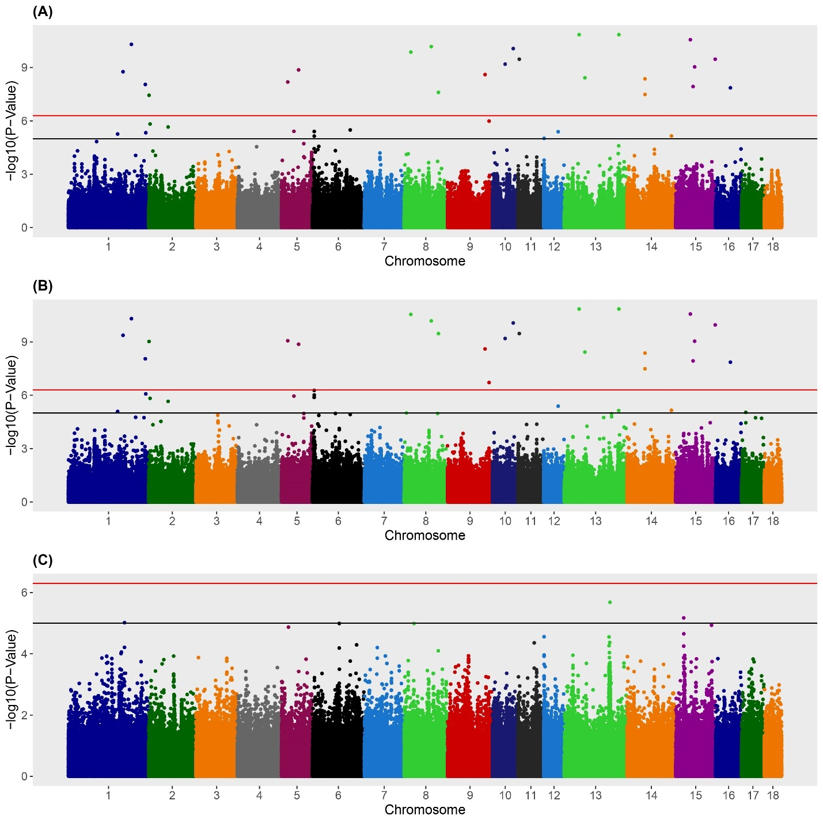
Figure 3: Manhattan plots for African swine fever virus (ASFV) infection status in Ugandan domestic swine using the full study population. A) Additive model, B) Dominant model, C) Recessive model. Black line denotes a moderate association (5 x 10⁻⁷ < P < 1 x 10⁻⁵) whereas the red line denotes a strong association (P < 5 x 10⁻⁷).

Slide 9
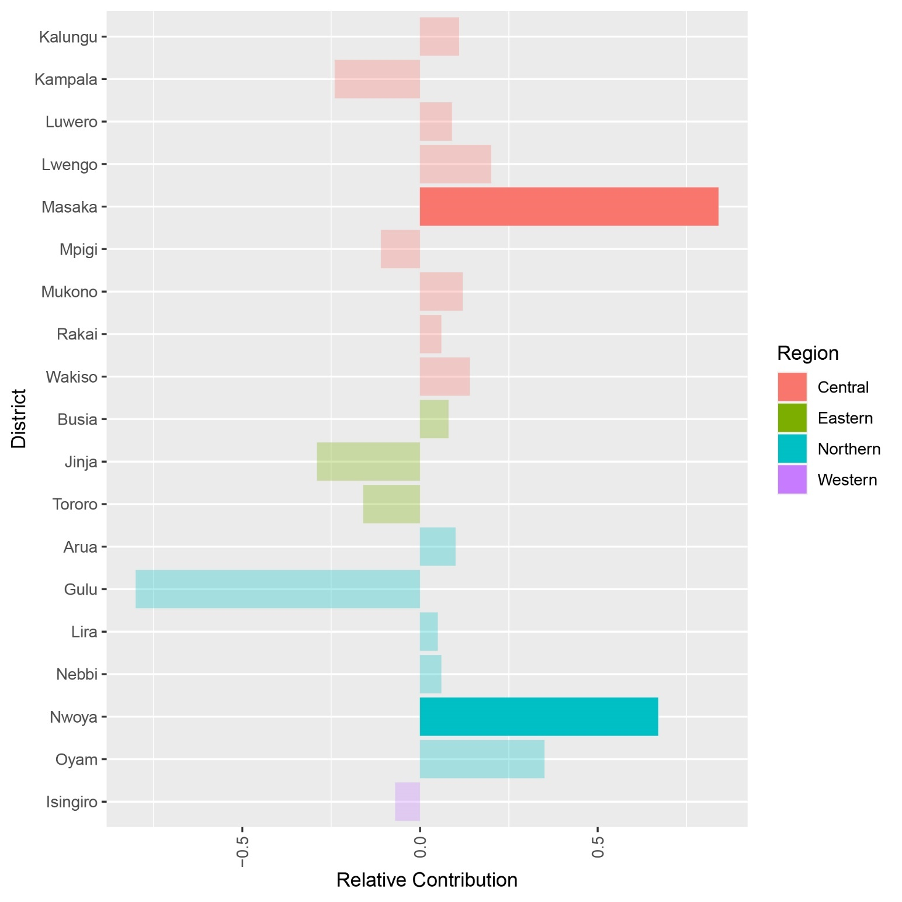
1 B: Pseudo heritability Evaluation (full study population)
Figure 4: Relative contribution of Ugandan districts to the pseudo-heritability estimate for African swine fever virus (ASFV) infection status generated using the full study population. Districts that are not significant contributors are represented by transparent bars.
Significant Pseudo heritability contribution observed from the districts of Masaka and Nwoya only

Slide 10
Sub-set Study population
2 A: Genome-wide Association Study
Table 3: Summary of genome-wide association studies for the sub-set study population
Mode of Inheritance | Covariate(s) | Pseudo-heritability | Std Error of heritability | Pseudo Lambda | Significant SNP
Additive | NA | 0.11 | 0.30 | 1.01 | 0
Dominant | NA | 0.11 | 0.30 | 1.00 | 2
Recessive | NA | 0.11 | 0.30 | 1.04 | 4
Only 06 Significant SNP

Slide 11
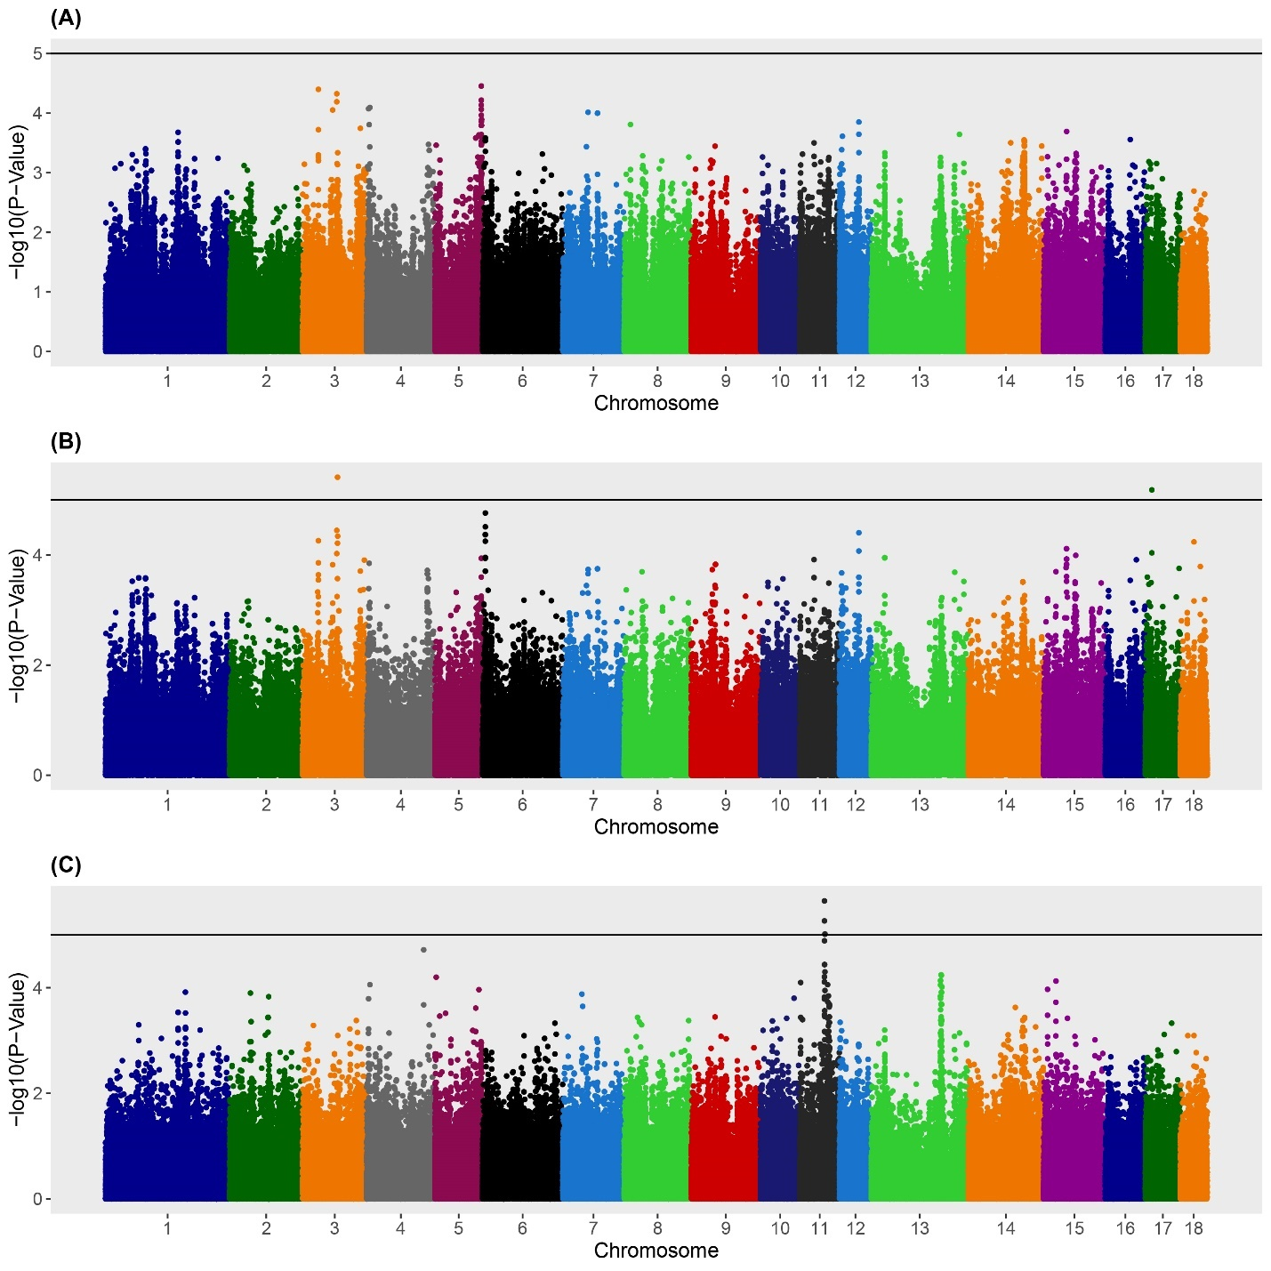
Figure 5: Manhattan plots for African swine fever virus (ASFv) infection status in Ugandan domestic swine using the operation level study population. A) Additive model, B) Dominant model, C) Recessive model. Black line denotes a moderate association (5 x 10⁻⁷ < P < 1 x 10⁻⁵).

Slide 12
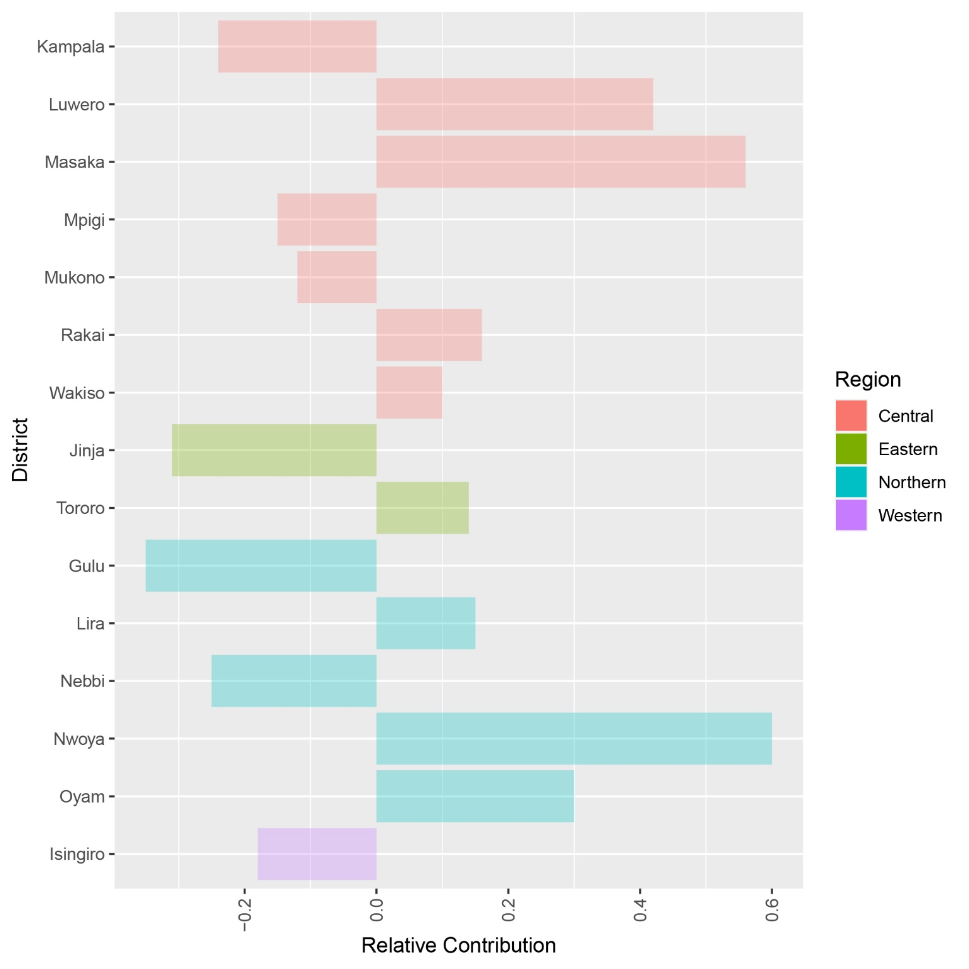
2 B: Pseudo-Heritability Evaluation
Figure 6: Relative contribution of Ugandan districts to the pseudo-heritability estimate for African swine fever virus (ASFv) infection status generated using the sub-set study population.
No significant h² contribution from the districts in the study

Slide 13
DISCUSSION AND CONCLUSION
No clear evidence to support a genetic basis for ASFV resistance among Ugandan survivor pigs.
Heritability of ASFv resistance among Ugandan pigs still needs a deeper exploration.

Slide 14
THANK YOU ALL
ACKNOWLEDGEMENTS
MAK
Assoc. Prof. Charles Masembe
Assoc. Prof. Vincent B. Muwanika
Peter Ogweng
Johnson F. Mayega
APHIS-USDA
Dr. Antoinette J. Piaggio
Dr. Timothy J. Smyser
Michael Marlow
Dr. Vienna R. Brown
Dr. Courtney Bowden

